Slide 1

Packet Capturing in Kali Linux
BK Birla Institute of Engineering & Technology
Department of Computer Science & Engineering
Project Guide:
Sanjeev Sultania
Group Members :
19EBKCS087 Priyansh Jain
19EBKCS121 Vinay Sharma

Slide 2
Understanding Kali Linux:
Kali Linux is a powerful operating system used for ethical hacking and packet capturing. It provides various tools and features for capturing and analyzing network traffic. Understanding Kali Linux is essential for a successful college project on packet capturing.

Slide 3
Importance of Packet Capturing in Network Security
Packet capturing plays a crucial role in network security. It helps analyze and monitor network traffic to detect vulnerabilities, identify potential threats, and prevent data breaches. Understanding the importance of packet capturing in network security is essential for a successful college project and a career in cybersecurity.

Slide 4
Analyzing Captured Packets for Network Vulnerabilities
Analyzing Captured Packets for Network Vulnerabilities
Analyzing captured packets can help identify network vulnerabilities, such as unsecured protocols, unauthorized access attempts, and suspicious traffic patterns. This information can be used to strengthen network security and mitigate potential threats. Understanding how to analyze captured packets is essential for a professional approach to a college project on packet capturing in Kali.

Slide 5
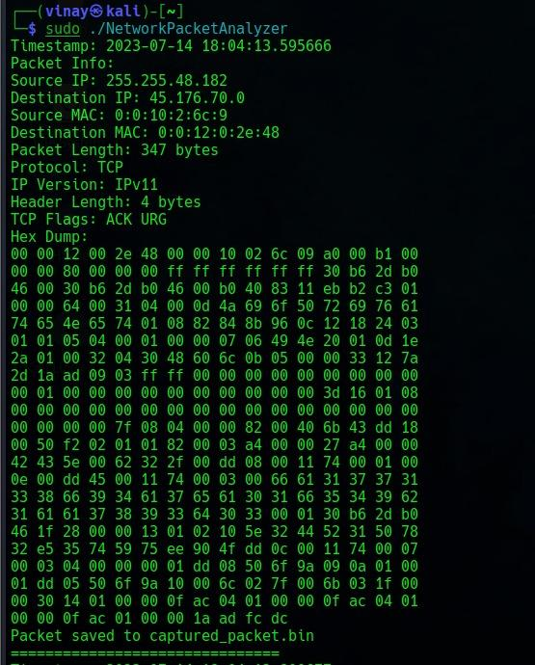
Captured Packet:

Slide 6
Why is packet capturing useful?
Can be used to see what data is being sent and received over a network
Can be used to identify network problems
Can be used to improve network security

Slide 7
Best Practices for Effective Packet Capturing
Best Practices for Effective Packet Capturing:
1. Use a high-quality network interface card (NIC) for accurate capture.
2. Set appropriate filters to focus on relevant packets.
3. Capture packets in real-time or save to a file for analysis.
4. Consider capturing packets at various network points for comprehensive analysis.
5. Use tools like Wireshark for packet analysis and troubleshooting.
6. Document and label captured packets for easy reference.

Slide 8
Real-World Applications and Case Studies
Real-World Applications and Case Studies:
Explore real-world applications of packet capturing in fields like network security, network performance analysis, troubleshooting, and forensic investigation. Review case studies highlighting the effectiveness of packet capturing in identifying network vulnerabilities and resolving issues.

Slide 9
Ethics and Key Takeaways
The legal implications of packet capturing:
In some cases, it may be illegal to capture network traffic without the consent of the parties involved
It is important to be aware of the legal implications of packet capturing before using it
It is important to use packet capturing ethically
Do not capture traffic that you do not have permission to capture
Do not use packet capturing to spy on others

Slide 10

Thank you!
Thank you for your time and attention.I hope you found this presentation informative and helpful.If you have any questions, please don't hesitate to contact me.
Thank you again!

